Slide 1

Graphical Representation
Dr. Abolfazl Saghafi
Assistant Professor of Statistics
Data Science Program Director
Notes:
We review some charts and tables in order to summarize data in this session
These slides are summary of class handouts which include full introduction to the subject

Slide 2
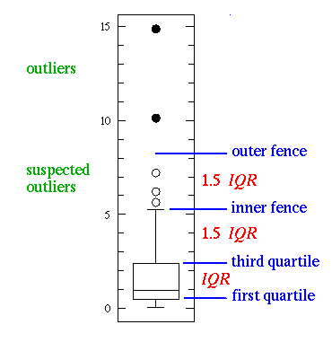
Summary
● Qualitative Data
● Frequency Table
● Bar/Pie Chart
● Quantitative Data
● Histogram
● Box Plot
● Bivariate Graphs
Notes:
We focus separately on charts used for describe qualitative and quantitative data, then we close the session with bivariate data representation.

Slide 3
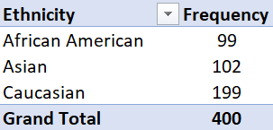
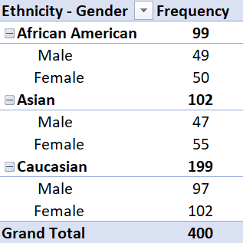
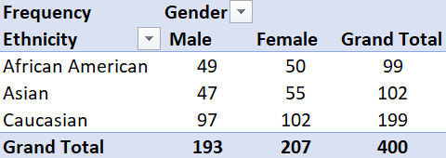
Frequency Table
A frequency table displays the frequency of various outcomes in a sample.
Here we have a frequency table for variable Ethnicity in the credit dataset.
We can use the table for two variables either in a tree diagram formation where counts are listed down in branches or cross-table form where counts are listed jointly.
Notes:
For qualitative data, a frequency table displays the frequency of various outcomes in a sample. Here we have a frequency table for variable Ethnicity in the credit dataset.
We can use the table for two variables either in a tree formation where counts are listed down in branches or cross-table where counts are listed jointly. These two tables show counts within two variables, ethnicity and gender. The first table has a tree diagram form where the first branch is ethnicity and second branch is gender. The second table shows counts jointly for the two variables, i.e. we can see that there are 49 Male African Americans in the sample.

Slide 4
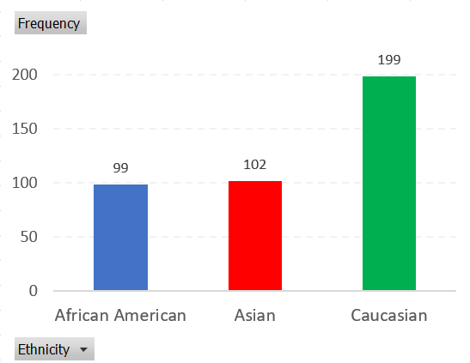
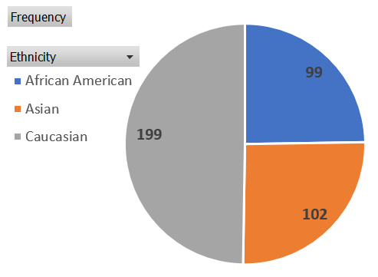
Bar Chart / Pie Chart
• Different categories of the qualitative variable on x-axis
• Frequency or Relative Frequency of each category is on y-axis
• Bars could be horizontal as well
A bar chart presents data with rectangular bars where heights is proportional to the frequencies they represent. We can graph a bar chart for more than two qualitative variables in grouped or stacked formation.
A pie chart is a circular graph which divides the circle into slices to illustrate numerical proportion.
Notes:
A bar chart presents QUALITATIVE data with rectangular bars where heights are proportional to the frequencies they represent. You see an example here for variable ethnicity. A Pie chart is another way to represent qualitative data.

Slide 5
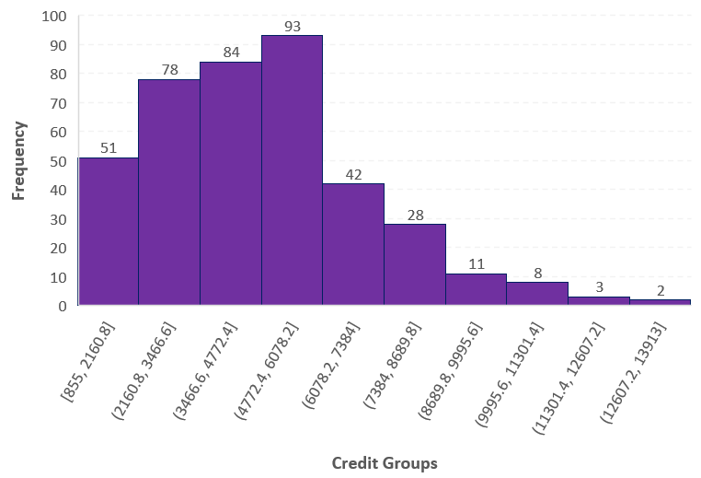
Histogram
A kernel chart is derived by connecting the centers on top of bars after adding one category to the beginning and end.
A histogram is a representation of frequency of observations within different categories.
Here we have a histogram for variable credit limit in the credit dataset.
• Number of categories is usually between 5 and 12
• We comment on the shape of a histogram, symmetric or skewed (left/right)
• We look for outliers
Notes:
A histogram is a representation of frequency of observations within different categories for QUANTITATIVE data. Here we have a histogram for variable credit limit in the credit dataset.
• Number of categories is usually between 5 and 12
• We comment on the shape of a histogram, symmetric or skewed (left/right)
• We look for outliers
A kernel chart is derived by connecting the centers on top of bars after adding one category to the beginning and end.

Slide 6
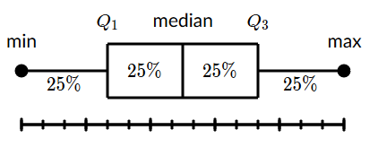
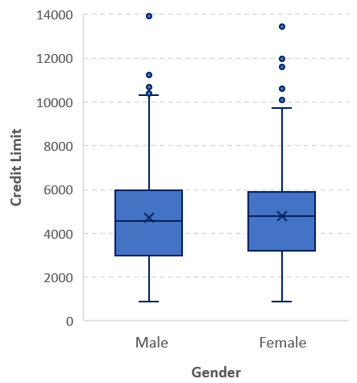
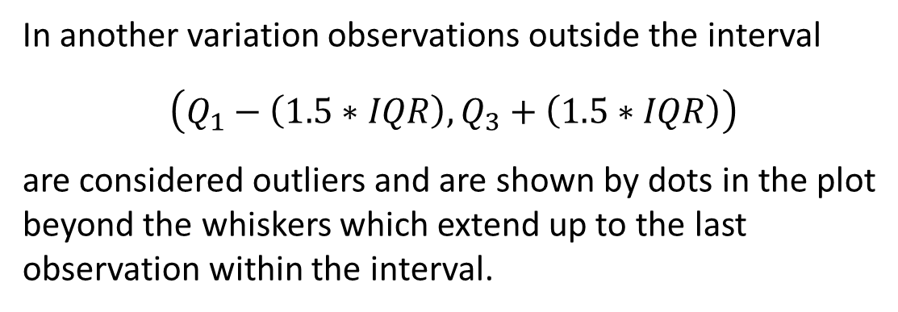
Box Plot
A box and whisker plot, also called a box plot, displays the five-number summary of a set of data. The five-number summary is the minimum, first quartile, median, third quartile, and maximum.
We draw a box from the first quartile to the third quartile. A vertical line goes through the box at the median. The whiskers go from each quartile to the minimum or maximum.
In another variation observations outside the interval
$$\left(Q_{1}−\left(1.5∗IQR\right),Q_{3}+\left(1.5∗IQR\right)\right)$$
are considered outliers and are shown by dots in the plot beyond the whiskers which extend up to the last observation within the interval.
Notes:
A box and whisker plot, also called a box plot, displays the five-number summary of a set of QUANTITATIVE data. The five-number summary is the minimum, first quartile, median, third quartile, and maximum. We draw a box from the first quartile to the third quartile. A vertical line goes through the box at the median. The whiskers go from each quartile to the minimum or maximum.
In another variation observations outside the interval $\left(Q_{1}−\left(1.5∗IQR\right),Q_{3}+\left(1.5∗IQR\right)\right)$ are considered outliers and are shown by dots in the plot beyond the whiskers which extend up to the last observation within the interval.
This box plot here is for variable credit limit and is graphed side-by-side for the two gender groups. You see that the patterns are similar. There are a couple of outliers. The average is also shown in the plot by a cross which is close to the middle bar, representing the median.

Slide 7
Bivariate Graphs
The Response or Dependent Variable is the outcome of a study. A variable you would be interested in predicting or estimating.
When trying to explore and describe information from two variables, we have different options depending on the type of response and independent variables.
The Predictor or Independent Variable is used to explain and predict the response variable.
Response Variable
Categorical Numerical
Side-by-Side Box Plots
Scatterplot
Graphing side-by-side box plots is discussed in the lab session. Scatterplots is practiced later in regression chapter.
Predictor Variable
Categorical Numerical
Cross-Table
Grouped Bar chart
Side-by-Side Box Plots
Notes:
To investigate whether there is relationship between some variables, we plot bivariate charts and tables. The type of illustrative chart depends on the type of both response and predictor variable.

Slide 8
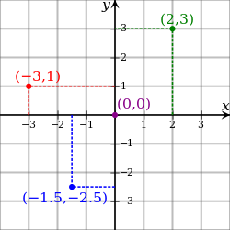
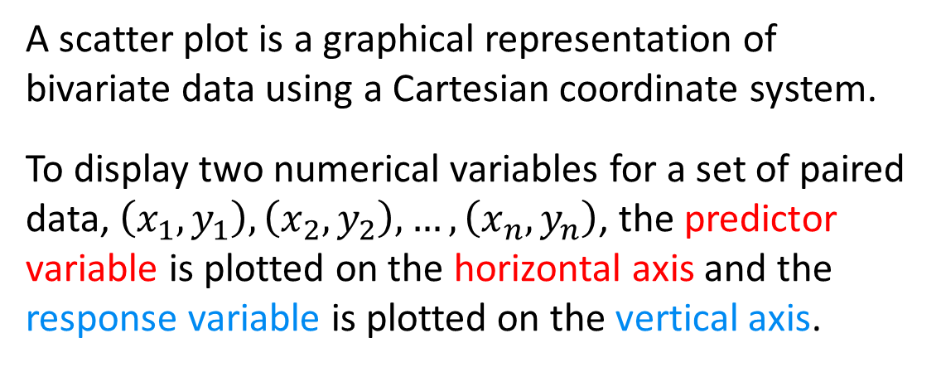
Scatterplot
A scatter plot is a graphical representation of bivariate data using a Cartesian coordinate system.
To display two numerical variables for a set of paired data, $\left(x_{1},y_{1}\right),\left(x_{2},y_{2}\right),…,\left(x_{n},y_{n}\right)$, the predictor variable is plotted on the horizontal axis and the response variable is plotted on the vertical axis.
Upon graphing a scatterplot we investigate
• the overall pattern of the plotted points
• the direction and shape of the pattern (if any)
• whether there are any outliers
On scatterplots each dot represents bivariate information for one sample unit.
Notes:
Scatterplot is descriptive graph using Cartesian coordinates to display values of typically two variables for a set of data. Each point in the plot represents information for one individual.
After graphing a scatterplot, we study the existence of any pattern in the plotted points, if there is a pattern, we note its direction and strength, and we report whether there are any outliers.

Slide 9
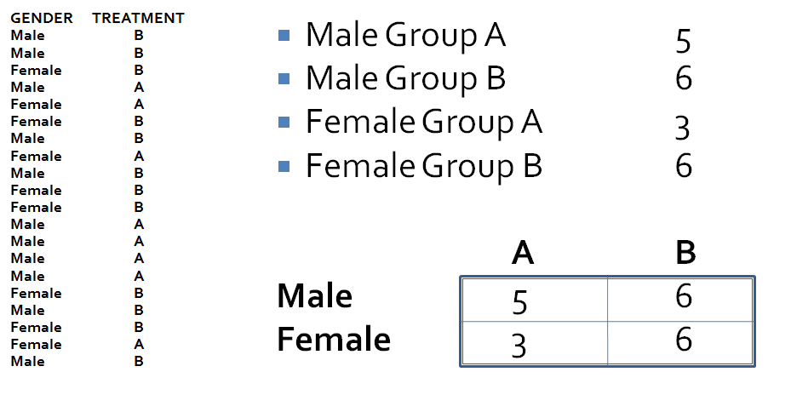
Cross Table
This table can be generated in excel easily using Pivot table tools.
A Cross table is a frequency distribution for a two variables at once.
1. One variable is assigned to horizontal axis and one to vertical.
2. Joint counts within each combination of categories is placed on a matrix formation.
Notes:
Just like a typical frequency table, count the number of observations within each of the four possible categories generated by variables Gender and Treatment. Then present the counts in a matrix form for each possible combination of the variables.

Slide 10
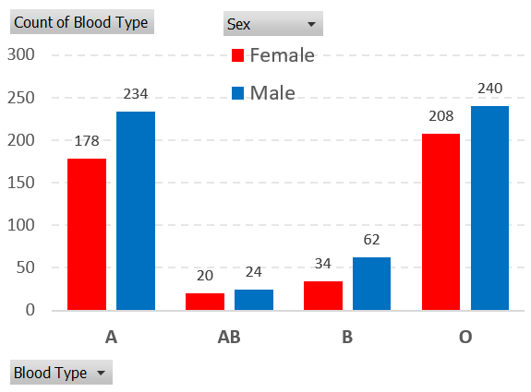
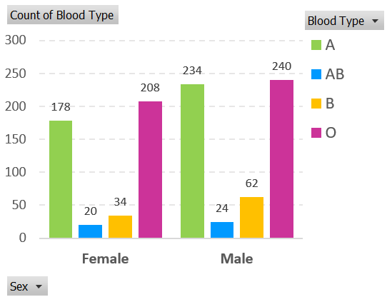
Grouped Bar Charts
Similar to bar charts, x-axis is divided into groups depending on different combinations of the response and predictor variables. Then, a bar is graphed with height proportional to frequency of observations in each combination.
In this example, Sex is the response variable and Blood type is the predictor. Do you see any relationships? Explain.
This chart can be graphed in excel using Pivot table tools after dragging one variable into column and one into row space.
Notes:
We can graph a bar chart for more than two qualitative variables in grouped or stacked formation. Here we have a grouped bar chart for the number of participants in the sample based on gender and ethnicity. For a stacked bar chart, the gender frequencies are stacked on top of each other for different ethnicity categories.
The two versions of this grouped bar chart represent the same information. Since we are interested in comparing the response variable (Sex) for given predictors, the first chart seems to be easier to investigate.

Slide 11
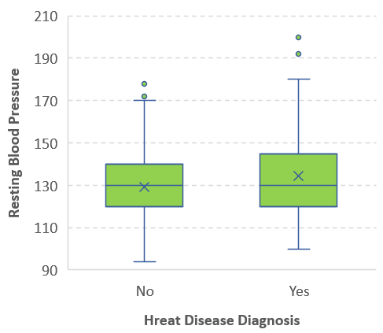
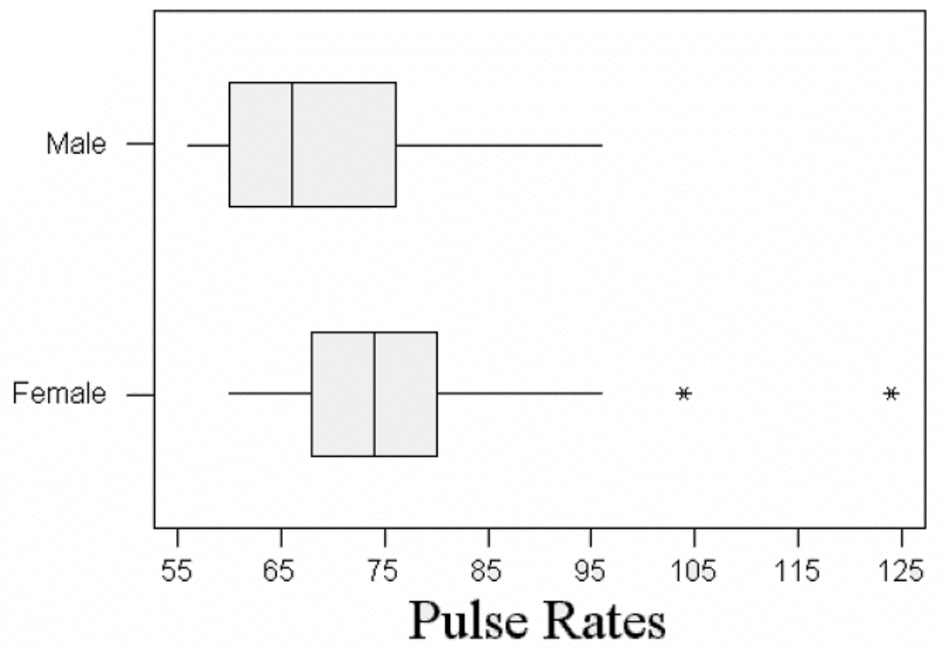
Side-by-side Box Plots
This chart can be graphed in excel using Pivot table tools after dragging one variable into column and one into row space.
Box plots generated for levels of a qualitative variable are used to investigate association between a qualitative and quantitative variable.
Notes:
The response variable in the box plots on the left is the pulse rate which is numerical. It is obvious that the pattern of pulse rate is different between the two genders. In the box plot on the right, the response is quantitative, whether people had diagnosed with heart disease. The Predictor variable is resting blood pressure.

Slide 12
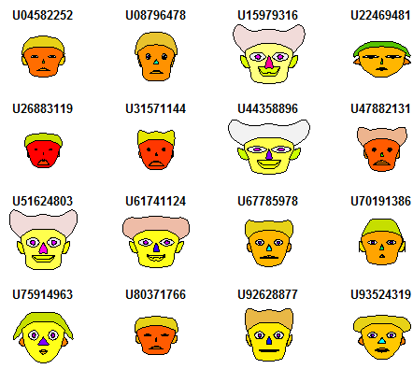
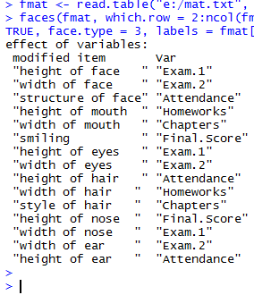




Multivariate Graphs
There are creative ways to illustrate many variables all at once in one chart. Chernoff faces is one of them.
Notes:
There are creative ways to illustrate more than two numerical variables all at once in one chart. Chernoff faces is one of them. In here each face represent information on 15 numerical variables! The interesting thing is that you can easily recognize which cases have similar values within what variables.

Slide 13
Summary Statistics
Dr. Abolfazl Saghafi
Assistant Professor of Statistics
Data Science Program Director
Notes:
We are reviewing central tendency and spread measures in this session

Slide 14
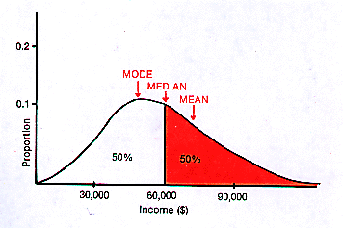
Summary
● Central Tendency Measures
● Mean, Median, Mode
● Spread Measures
● Variance and Standard Deviation
● Range, Inter-Quartile Range
● Other Measures
Notes:
We usually have three categories of measures describing QUANTITATIVE data, central measures, spread measures, and other measures.

Slide 15
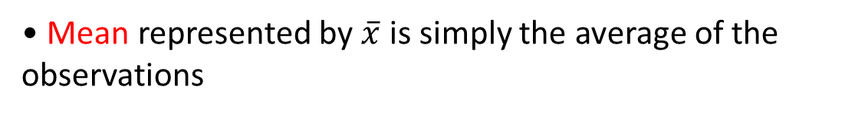
Central Tendency Measures
• For qualitative data, Mode is the only central tendency that makes sense
• When the data is skewed, the median is preferred over the mean or mode since it provides a better central value
• The mean has the lowest error, variance, in a symmetric or near symmetric distribution
Statistic whose values shows a center or typical value for distribution of data. The three most important central tendency measures are
• Mean represented by $\overline{x}$ is simply the average of the observations
• Median which is the middle value after sorting the data. Therefore, 50% of the observations are less than or equal to the median and 50% are greater than or equal to it
• Mode which is the most frequent observation, distributions can have more than one mode, the mode does not exist when a distribution is flat
Notes:
Statistic whose values shows a center or typical value for distribution of data. The three most important central tendency measures are
• Mean or average represented by $\overline{x}$
• Median which is the middle value after sorting the data. Therefore, 50% of the observations are less than or equal to the median and 50% are greater than or equal to it
• Mode which is the most frequent observation, distributions can have more than one mode, the mode does not exist when a distribution is flat
• For qualitative data, Mode is the only central tendency that makes sense
• When the data is skewed, the median is preferred over the mean or mode since it provides a better central value
• The mean has the lowest error, variance, in a symmetric or near symmetric distribution

Slide 16
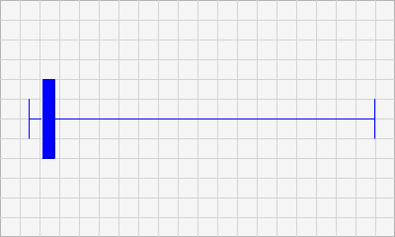
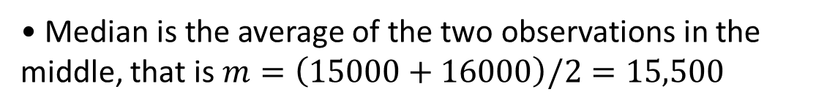
Example
Consider the wages of staff at a factory, sorted below,
12k 14k 15k 15k 15k 16k 17k 18k 90k 95k
Compute the central tendency measures and comment which value represents a better central value.
• $\overline{x}=\left(12000+…+95000\right)/10=30,700$
• Median is the average of the two observations in the middle, that is $m=\left(15000+16000\right)/2=15,500$
• Mode is $M=15,000$
Notes:
The median and mode here are better measures of center since the data is highly skewed to right, median is favorable

Slide 17
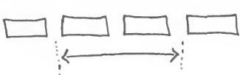

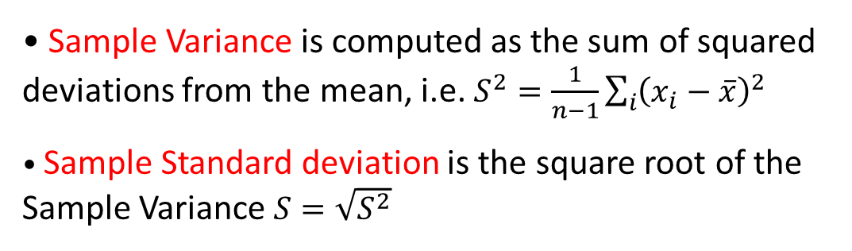
Spread Measures
Spread measures provide a value of dispersion, deviation or variability for a set of data. The most important ones for a set of data are
• Range represented by R is Max – min and shows the extent to which variation is possible
• Sample standard deviation has the same unit as the data itself and is computed using all the observations thus is favorable IF there are no outliers in the data
• ALL these measures provide a positive value representing spread of data
• If data is skewed, IQR provides a better spread measure.
• Inter-Quartile Range (IQR) is Q ₃ – Q ₁ which is computed after sorting the data and computing the first and third quartile
• Sample Variance is computed as the sum of squared deviations from the mean, i.e. $S^{2}=\frac{1}{n−1}\sum_{i}{{\left(x_{i}−\overline{x}\right)}^{2}}$
• Sample Standard deviation is the square root of the Sample Variance $S=\sqrt{S^{2}}$
Notes:
Spread measures provide a value of dispersion, deviation or variability for a set of data. The most important ones for a set of data are
• Range represented by R is Max – min and shows the extent to which variation is possible
• Inter-Quartile Range is Q ₃ – Q ₁ which is computed after sorting the data and computing the first and third quartile
• Sample Variance is computed as the sum of squared deviations from the mean, i.e. $S^{2}=\frac{1}{n−1}\sum_{i}{{\left(x_{i}−\overline{x}\right)}^{2}}$
• Sample Standard deviation is the square root of the Sample Variance $S=\sqrt{S^{2}}$

Slide 18
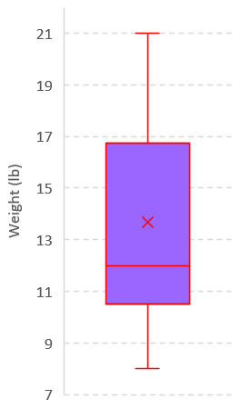
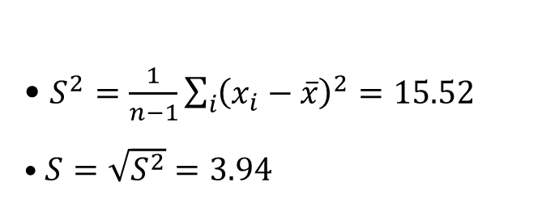
Example
The following data is from a random sample of 12 airline carry-on luggage weights rounded to the nearest pound. Compute the four discussed spread measures.
8 10 10 12 12 12 12 15 16 17 19 21
• R = Max – min = 21 – 8 = 13
• IQR = Q ₃ – Q ₁ = 16.5 – 11 = 5.5
• $S^{2}=\frac{1}{n−1}\sum_{i}{{\left(x_{i}−\overline{x}\right)}^{2}}=15.52$
• $S=\sqrt{S^{2}}=3.94$
Notes:
The box plot here uses a weighted procedure to compute the quartiles and the values are different from what we computed here.

Slide 19
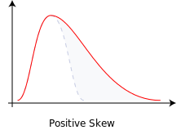
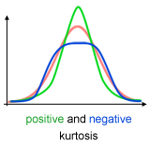
Other Measures
The following are some measures providing information on the shape of the distribution of data.
• Skewness is a measure of asymmetry for a distribution of data. It is equal to zero for symmetric distributions, positive if the right tail of the distribution is longer, negative if the left tail is longer.
• Kurtosis is a measure of flatness of a distribution. The bell-shaped Gaussian distribution has a kurtosis of 0. A flatter distribution has a negative kurtosis. A distribution more peaked than a Gaussian distribution has a positive kurtosis.
Notes:
The following are some measures providing information on the shape of the distribution of data.
• Skewness is a measure of asymmetry for a distribution of data. It is equal to zero for symmetric distributions, positive if the right tail of the distribution is longer, negative if the left tail is longer.
• Kurtosis is a measure of flatness of a distribution. The bell-shaped Gaussian distribution has a kurtosis of 0. A flatter distribution has a negative kurtosis. A distribution more peaked than a Gaussian distribution has a positive kurtosis.

